Slide 1
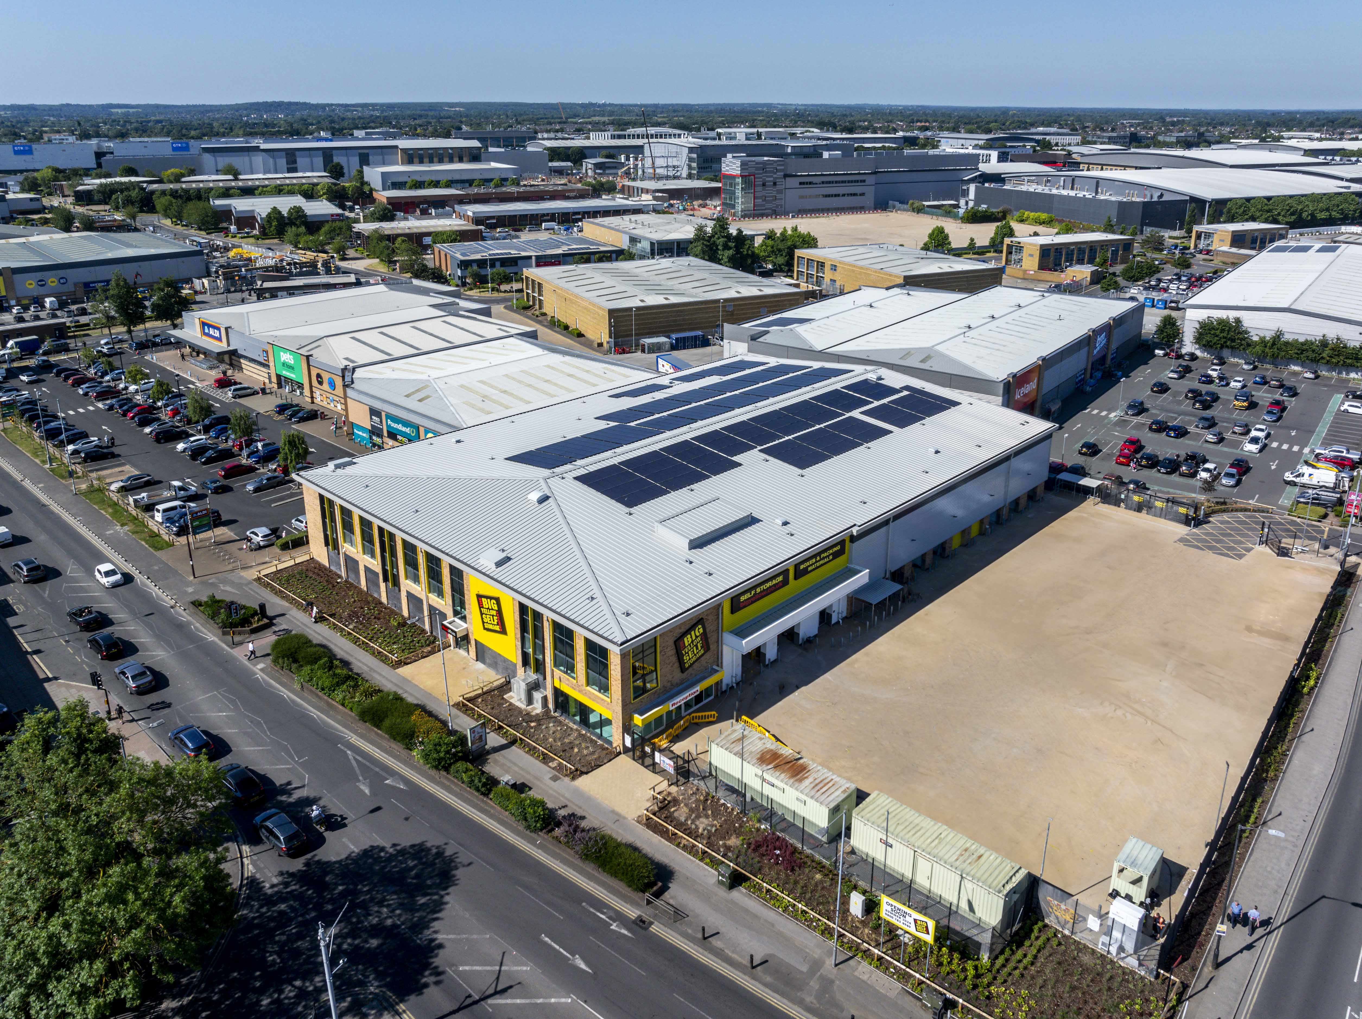
Big Yellow, Slough
Project Value £4.8m
Programme 35 weeks
This new build scheme within our Fast Track division included the construction of a new self-storage facility involving the initial demolition and strip out of the previous structure on site. Works also included the main building shell, steel frame erection, all associated external works and services. MCS have completed various Big Yellow schemes across the country including London, Enfield, Uxbridge and Guildford.

