Slide 1
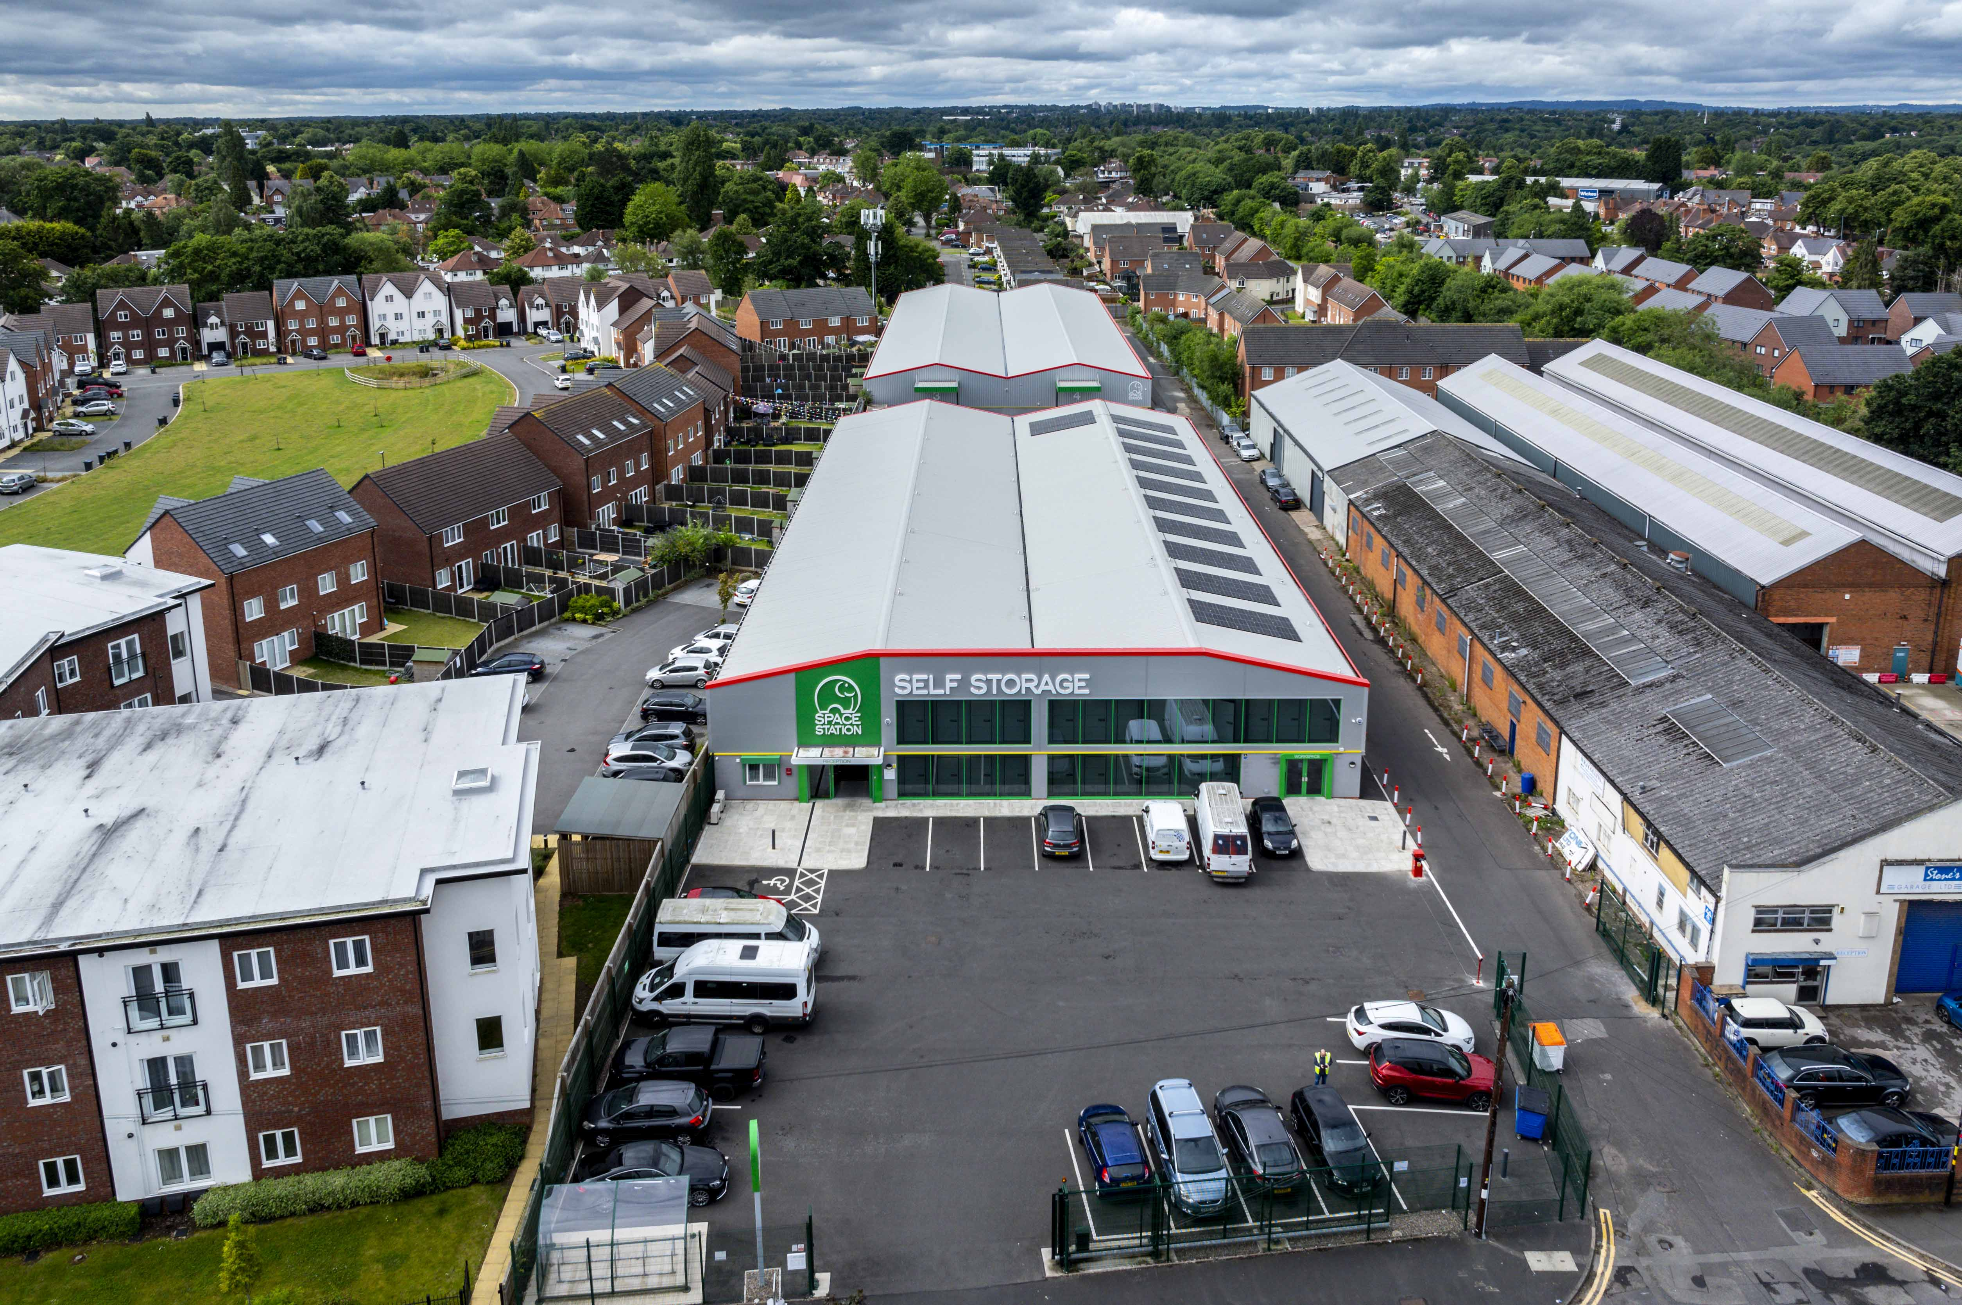
Space Station, Hall Green
Project Value £1.5m
Programme 18 weeks
This alteration and refurbishment project for our Fast Track division included enabling works to the roof and cladding, internal fit out, M&E installations and a new mezzanine floor.

