Slide 1
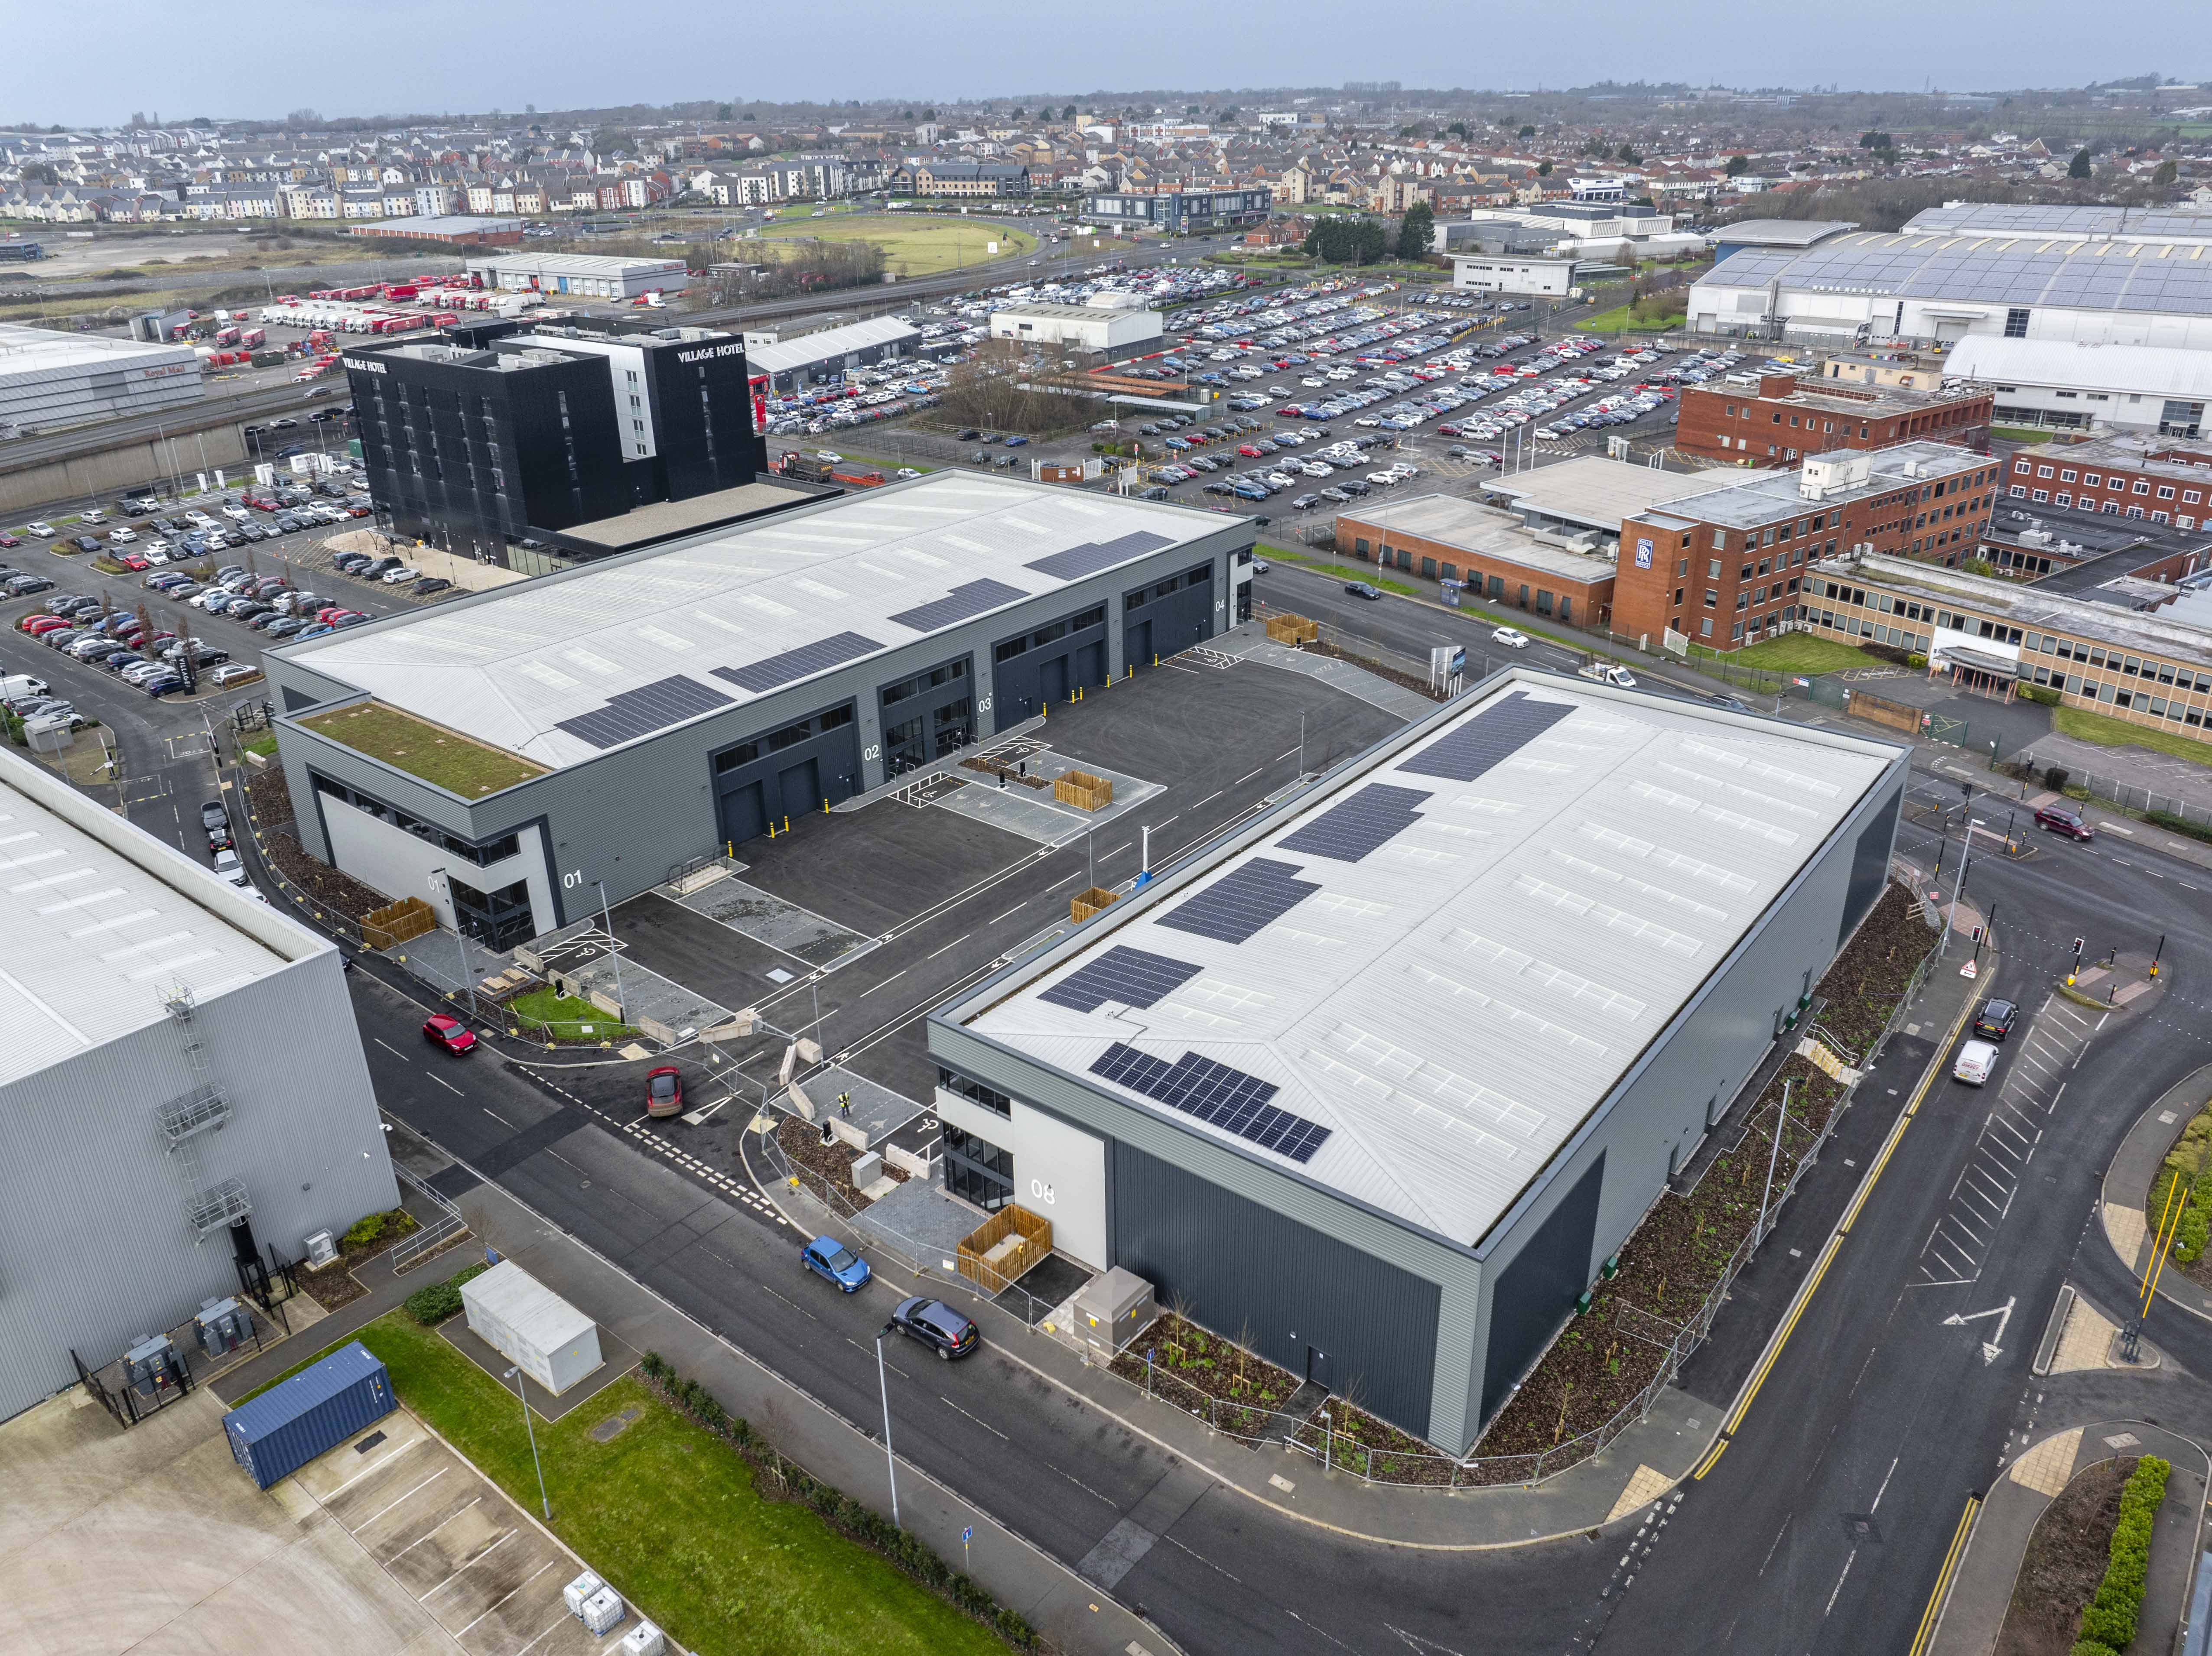
Cubex, Filton
Project Value £8m
Programme 38 weeks
New build 8 industrial units over 2 terraces including fit out and installation of EV chargers, landscaping, PV’s and cycle shelters, covering 5500m2 of internal space
BREEAM excellent and EPC A

