Slide 1
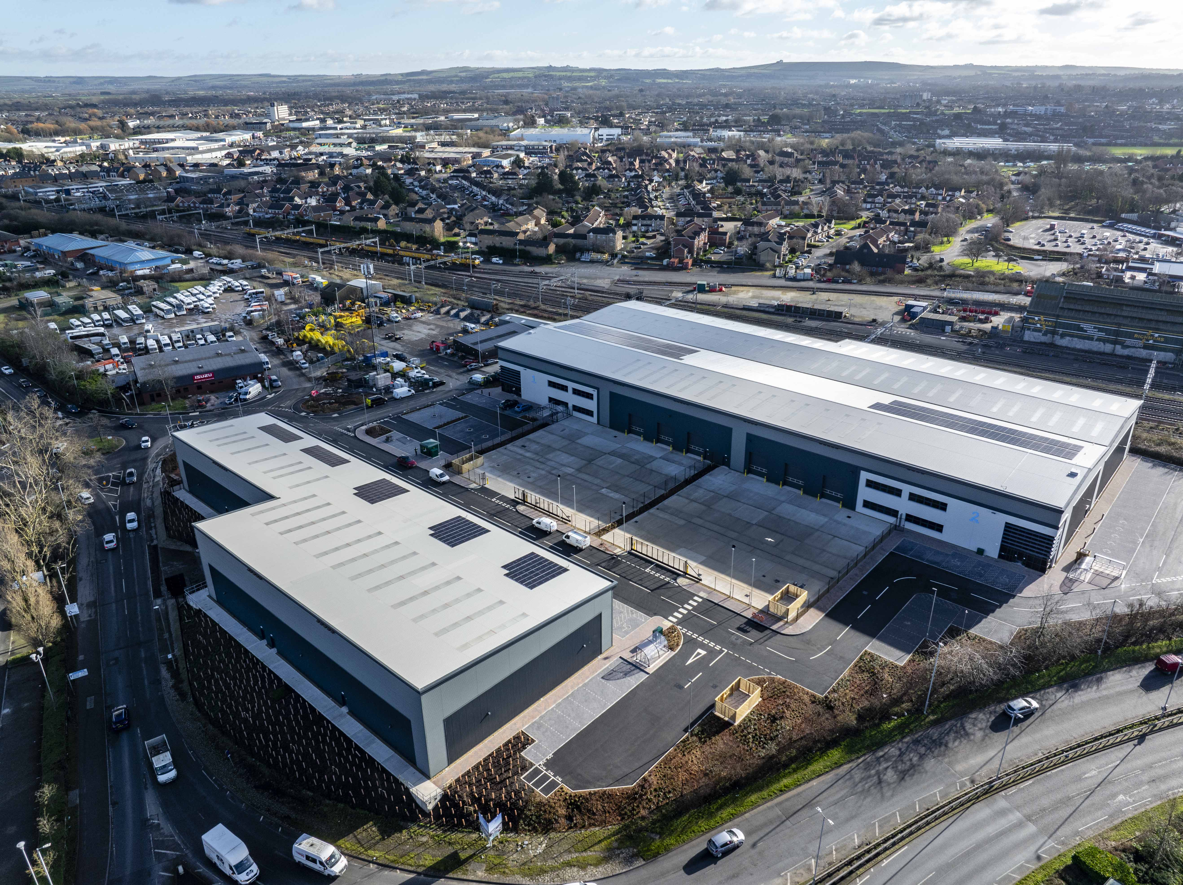
Cubex Swindon
Project Value £10.8m
Programme 36 weeks
This new build development consists of two separate buildings, split into 7 units. A range of 300 to 3500m2 floor plans across the units, including open plan offices, open plan warehouse style, lobbies/kitchen and toilet facilities. Works also included external parking, hardstanding and landscaping, erection of the steel frame, roofing and cladding.

