Slide 1
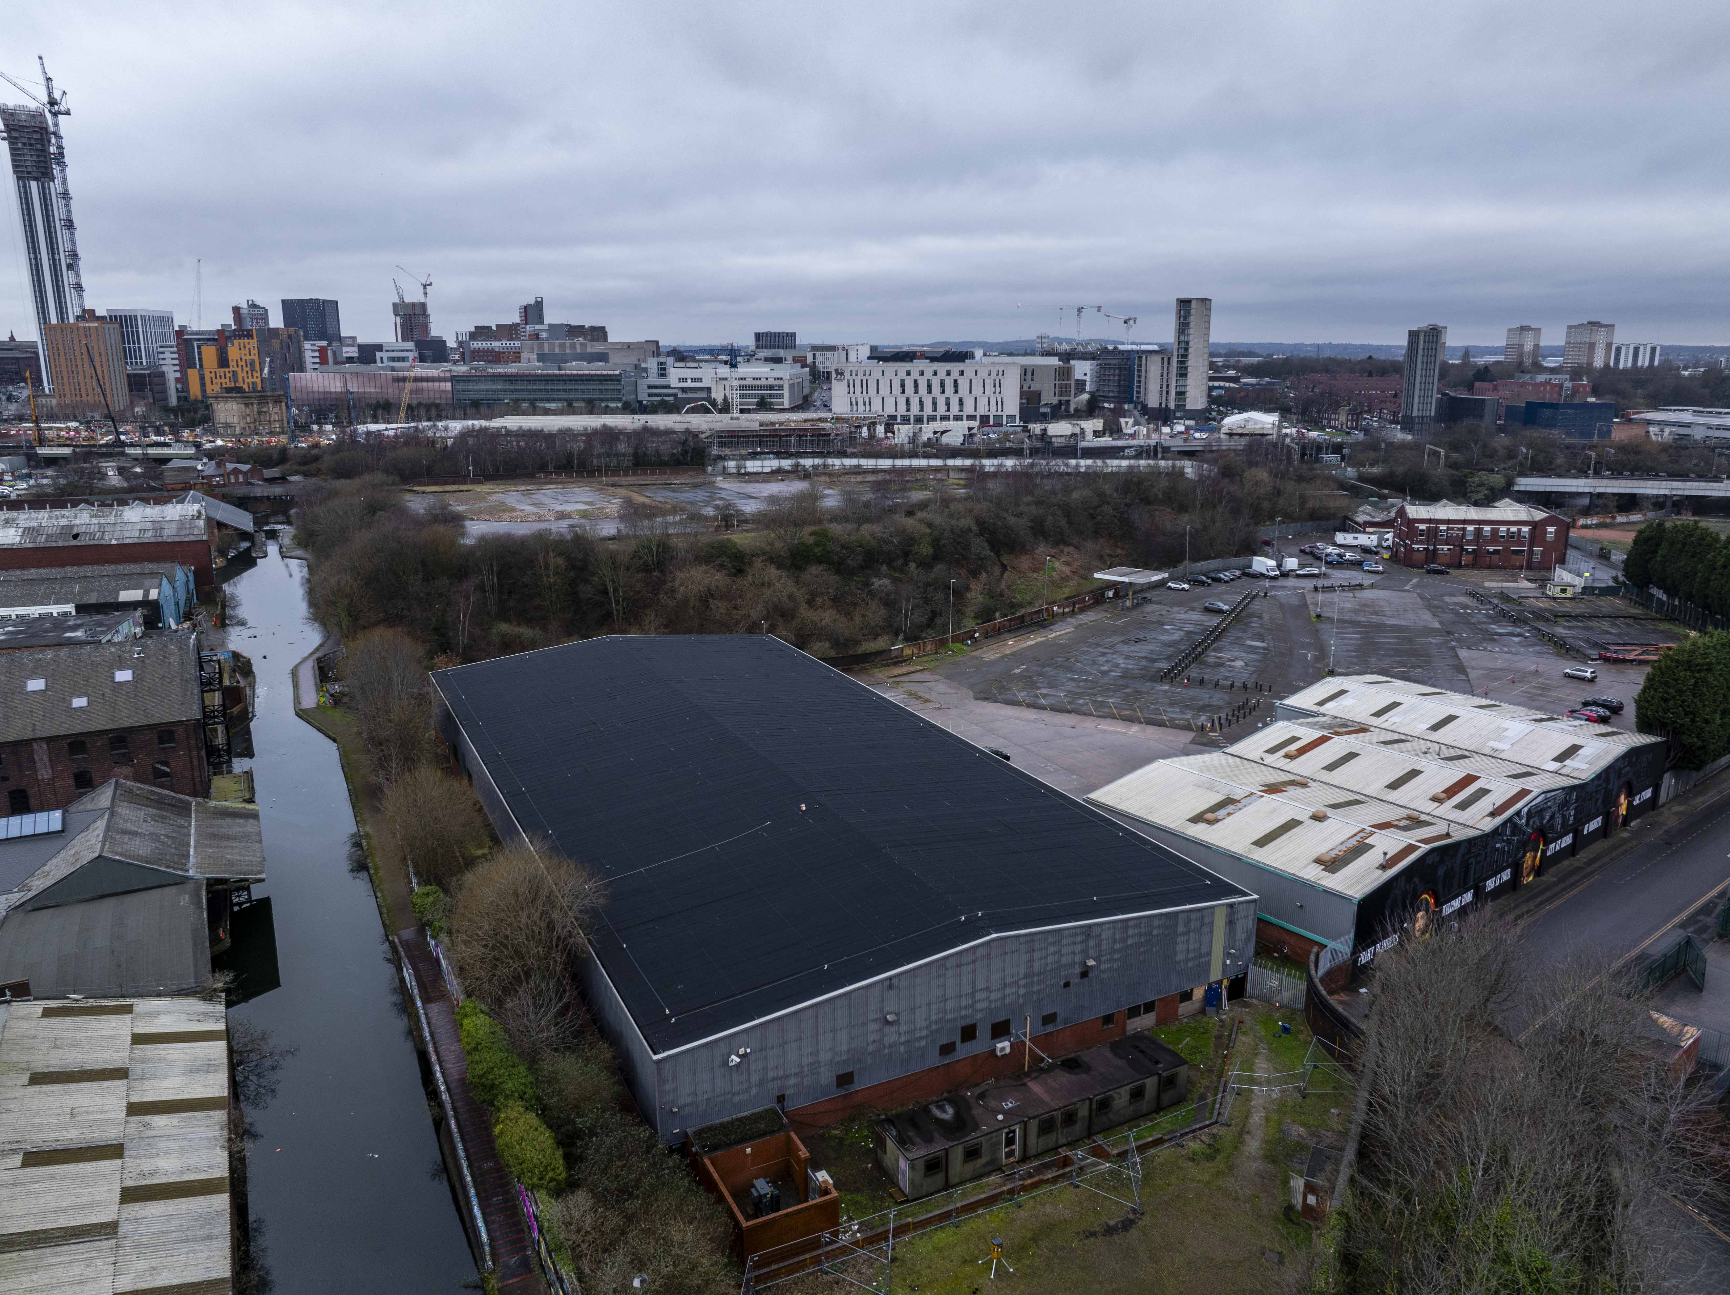
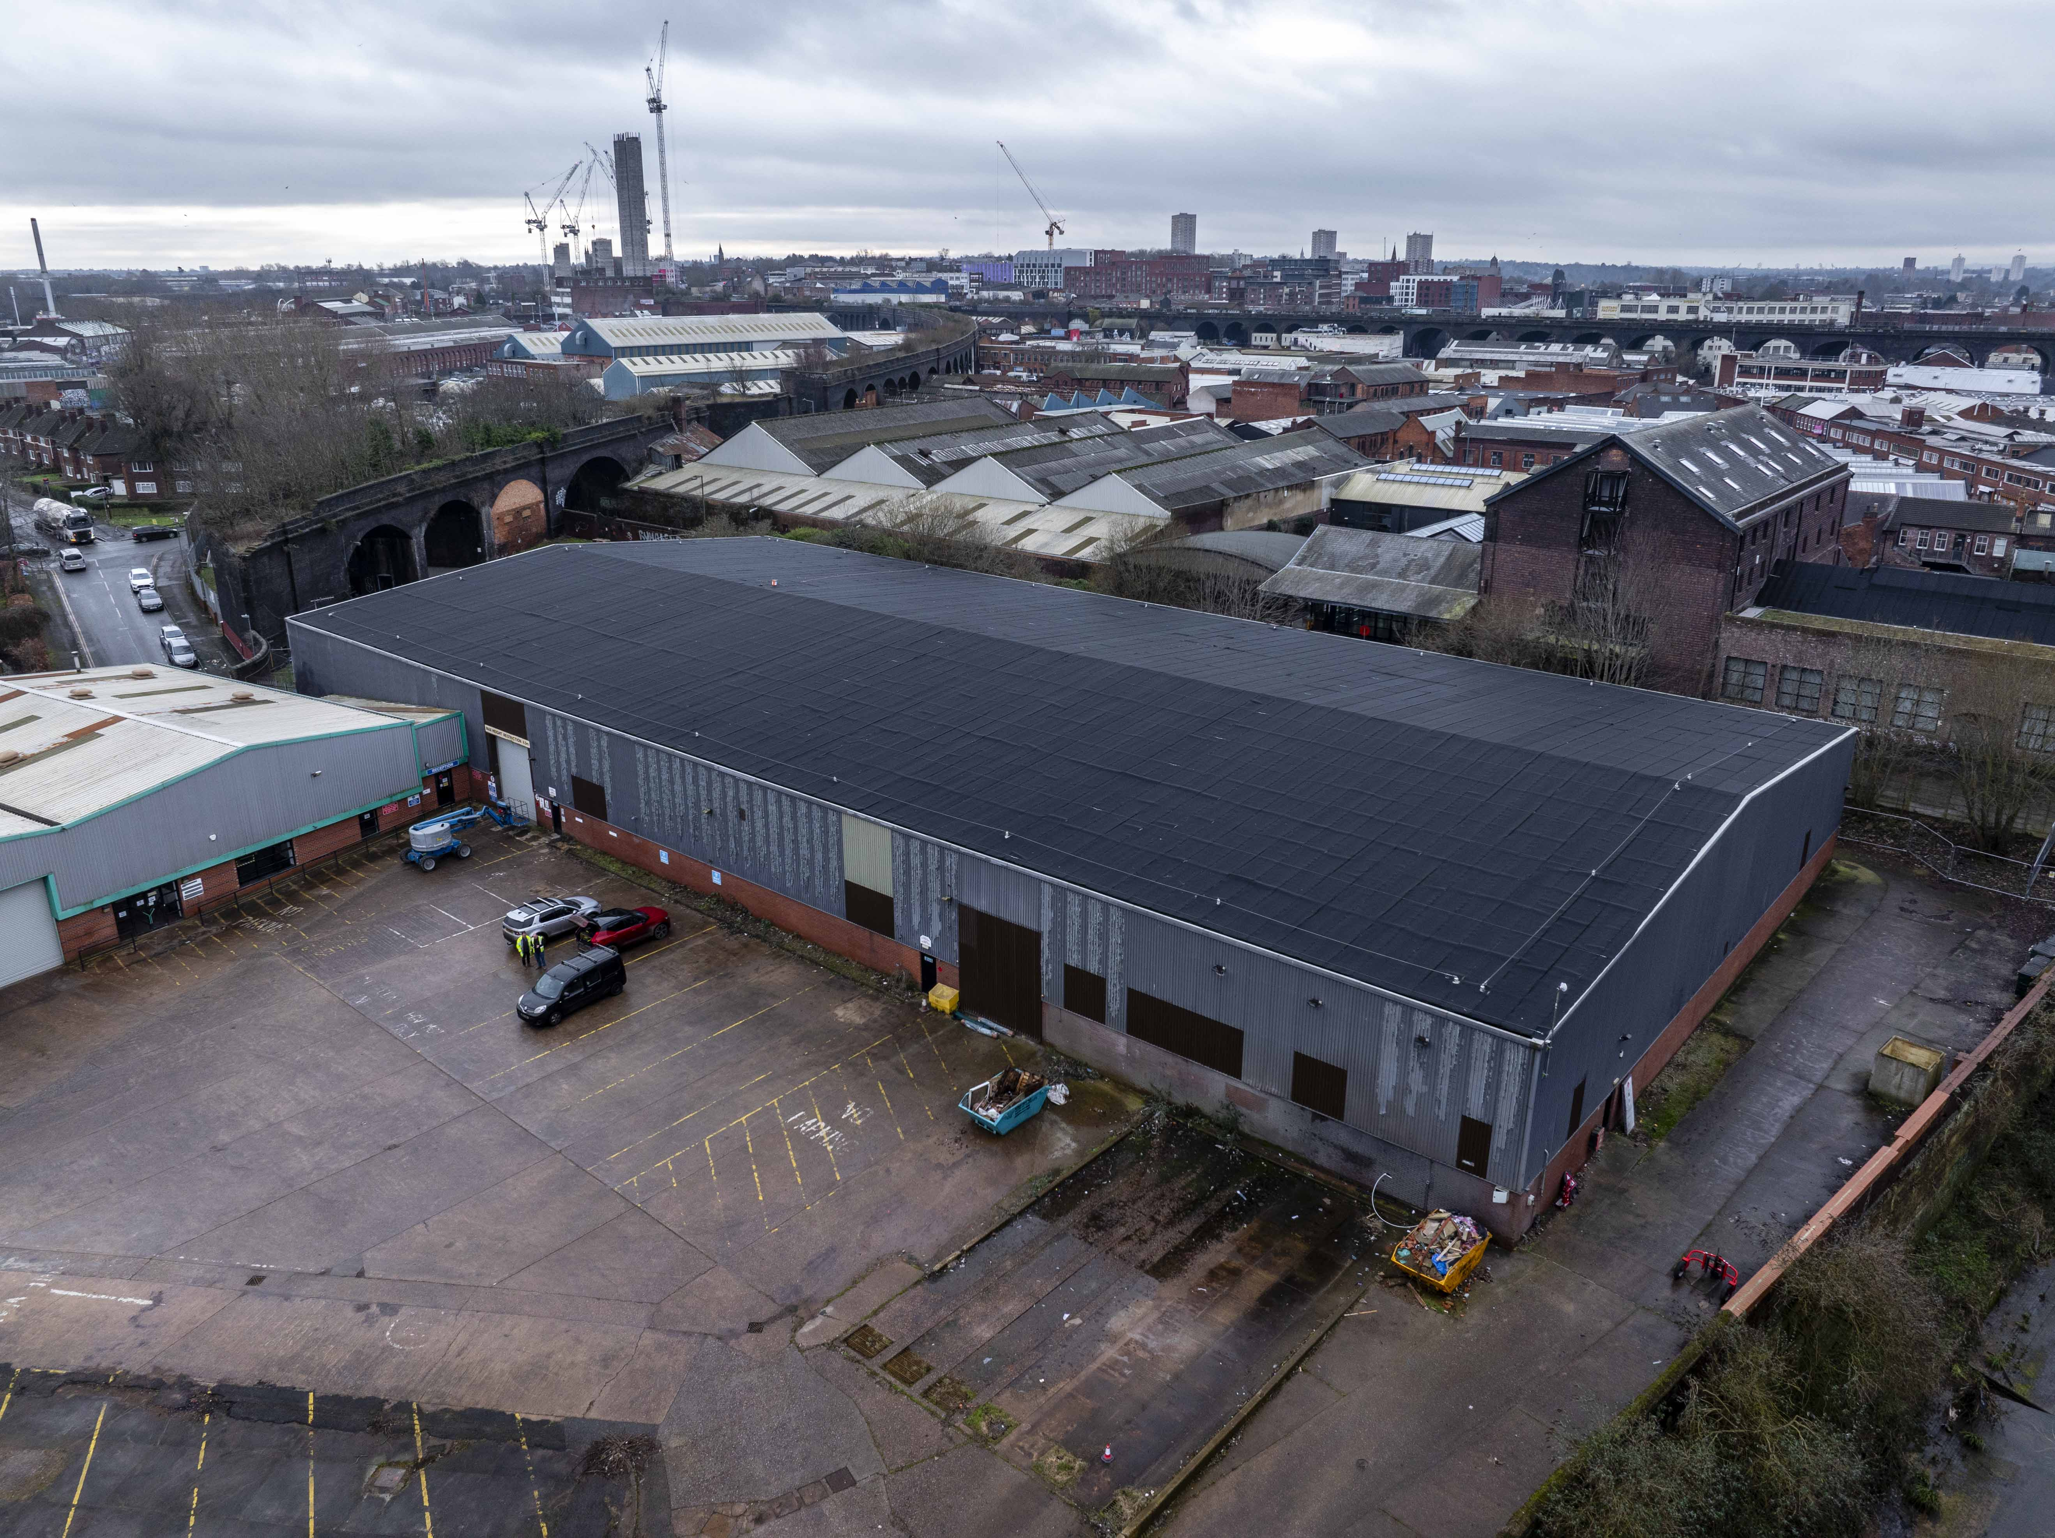
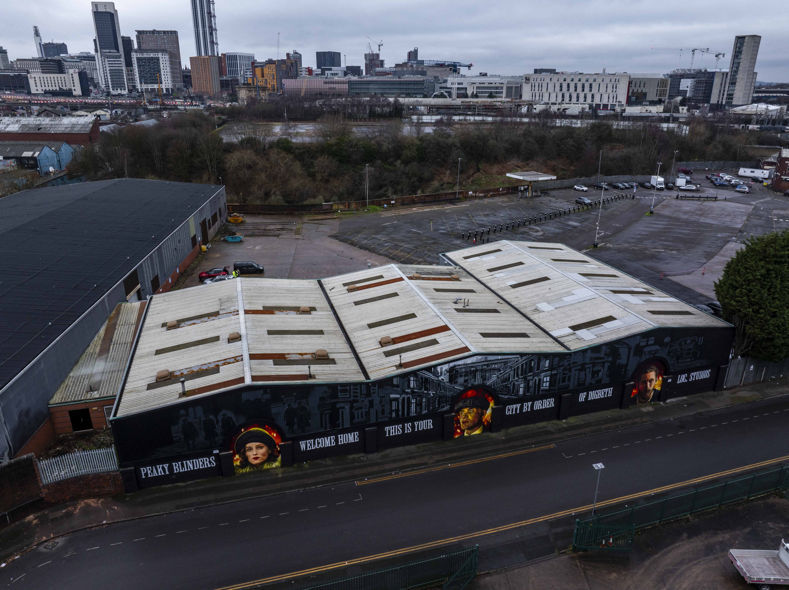
Digbeth Studios Montague Street
Project Value £319k
Programme 7 weeks
This warehouse development located on Montague Street in Digbeth, underwent repairs on damaged areas to the roof, cladding repairs and upgrades to the front elevations were also completed along with gutter repairs and down pipe upgrades, updates to the general electrics, servicing and repairs to the roller shutter doors, a silent roof repression system installation and new security/fire door upgrades.

