Slide 1

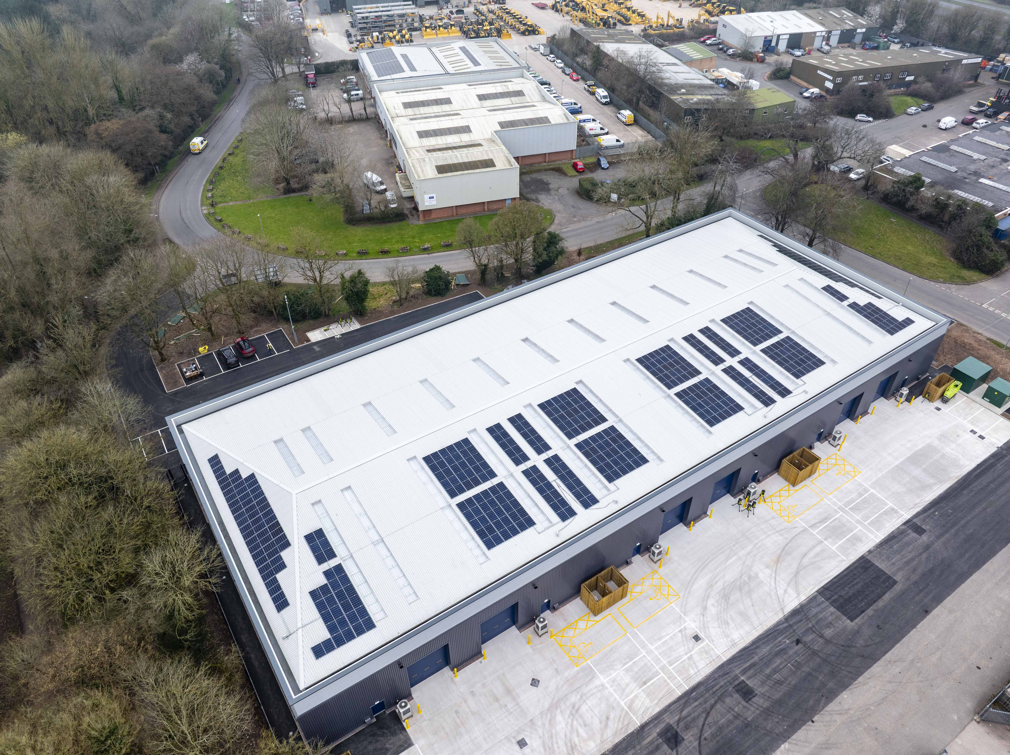


South Moons Moat Redditch
Project Value £4.4m
Programme 26 weeks
This design and new build development for our Special Projects division, included associated demolition works, site clearance, external works, drainage, utilities and landscaping works to create a single storey terraced style warehouse comprising of 6 units with office space and welfare facilities.

